Slide 1
RECOMMENDATION

Slide 2
RECOMMENDATION
A recommendation report is written to propose or recommend the options available to solve a problem or fill a need.
The goal of the report is to compare options, recommend one option, and support that recommendation.
Recommendation reports, like feasibility reports, may include supporting data, but they also state an affirmative position ("Here's what we should do and why")

Slide 3
Feasibility report and recommendation report
Feasibility report: This type studies a situation (for example, a problem or opportunity) and a plan for doing something about it and then determines whether that plan is "feasible"—whether it is practical in terms of current technology, economics, social needs, and so on. The feasibility report answers the question "Should we implement Plan X?" by stating "yes," "no,“. What are the pros and cons, and the alternatives?. Not only does it give a recommendation, it also provides the data and the reasoning behind that recommendation.
Recommendation report: This type starts from a stated need, a selection of choices, or both and then recommends one, some, or none. The recommendation report answers the question "Which option should we choose?"

Slide 4
As you can see, these distinctions are rather fine; and they overlap. In real-world writing, these types often combine—you might see elements of the recommendation report combine with the feasibility report
You provide not only your recommendation, choice, or judgment, but also the data and the conclusions leading up to it.

Slide 5
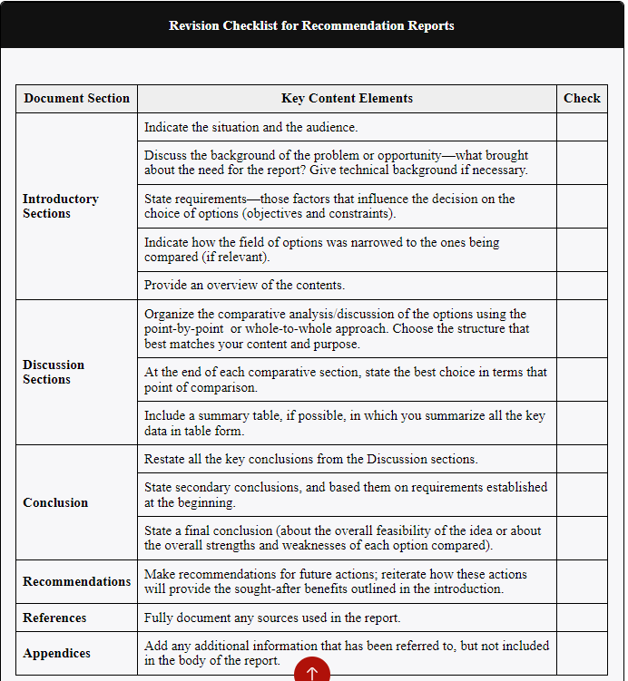

Slide 6
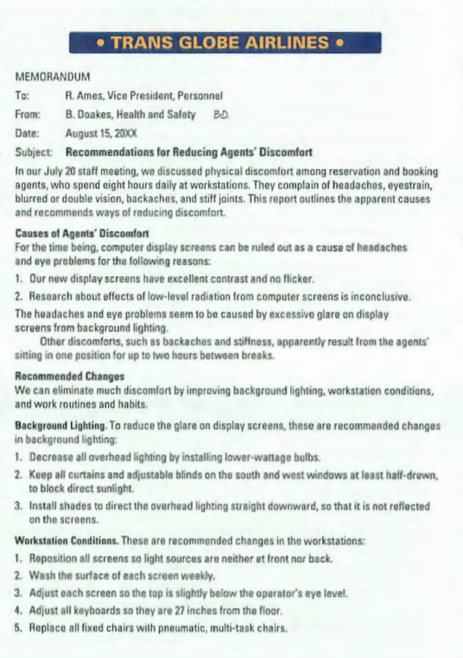
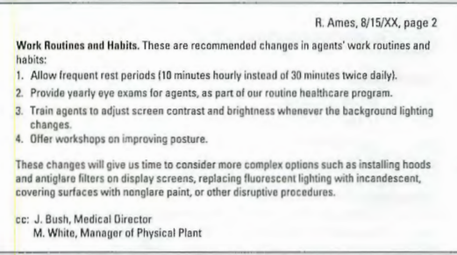

Slide 7
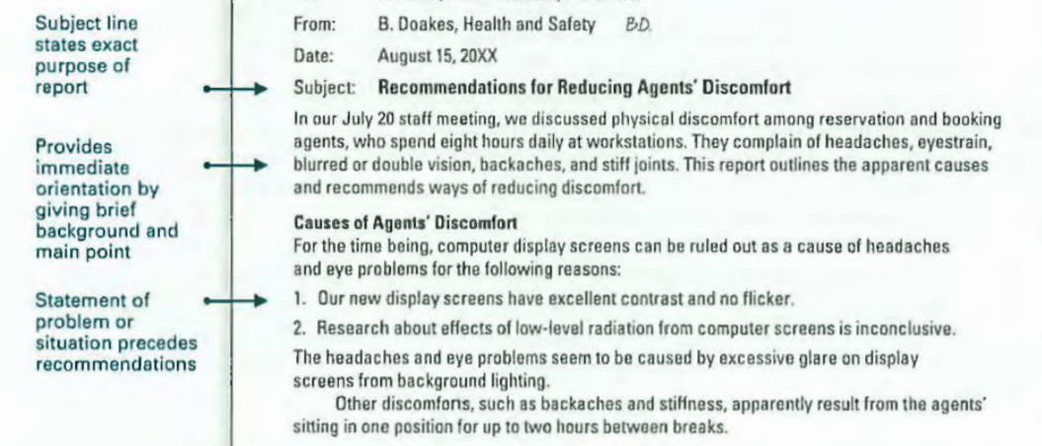

Slide 8
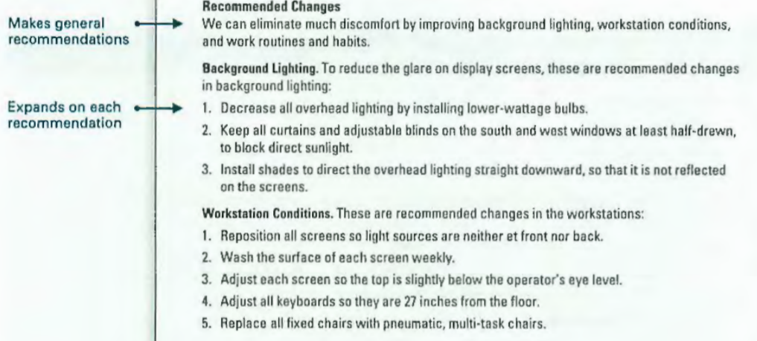

Slide 9
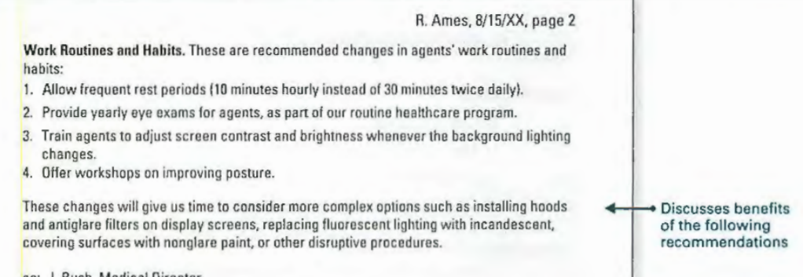

Slide 10
GUIDELINES
Before making a recommendation, make sure you've gathered the right information.
Provide a clear subject line.
Keep the background brief.
Summarize the problem or situation prior to making recommendations.
Use an authoritative tone.
Use informative headings.
End with a list of benefits for taking action.

Slide 11
The audience for a report is usually predetermined and specific with one or more groups examining various sections of the report.
Report writers must provide enough information so that the audience members can confidently follow the recommendations as informed members of the team.

